Slide 1

Jerry Downer
Realtor / Broker Associate
REAL Real Estate
Serving Colorado’s Real Estate Needs Since 2006
A Colorado Resident Since 1964

Slide 2
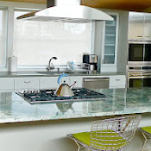
Welcome,
I realize that you have a choice when hiring an agent to help you sell your home and truly appreciate the opportunity to present my proven approach and the results I’ve achieved for my clients. As your agent, there are several services you can expect me to provide, including:
Accurately pricing your home,
Enhancing the perceived – and real – value of your home, enabling you to realize a higher selling price,
Providing unmatched marketing including professional staging, photography, and video
Securing a qualified buyer within your specific time frame,
Helping you avoid the two main reasons that sales fall apart – low lender appraisals and home inspection objection issues.
Regardless of the price of your home, when you hire me as your Realtor, both you – and your home – will be prepared for a successful sale.
Warm regards
Jerry Downer
REAL Real Estate
720-277-9001

Slide 3
OUR STRATEGY is to provide premium service to every client,
Far beyond the minimum legal requirements lightly used by most agents.
The Colorado Department of Real Estate requires all agents to provide certain minimum services to every client. While I won't list every one of them here, they don't really relate to marketing. Rather those services are more closely related to confidentiality, fiduciary, honesty, reasonable skill and care, among others. I'll provide the full list as part of our Agency Agreement, or if you prefer, I can send you a copy.
The reason that I mention this is that so many Real Estate Agents consider those minimal items on that list as sufficient and advertise themselves as Full-Service Agents. Seriously.
So let me just state that yes, we provide everything on that list as a most basic starting point. Then we add a whole bunch more for every Listing including:
1. Research Ownership and encumbrances
We use our Title Company partners to investigate the ownership history of the property to make certain that there are no hidden liens against the property that would interrupt the sale and cause unintended delays.
2. We protect your property
Most agents in the Denver area use cheap hardware store lockboxes that have a fixed combination code. These are inherently unsafe because it's very easy for a bad actor to steal the code and come back later and ransack the house...or worse. I can show you how they do it.
We use bluetooth-enabled electronic lockboxes that dynamically change the code for every showing. It is virtually impossible to crack the code.

Slide 4
OUR STRATEGY is to provide premium service to every client
(continued)
3. Professional HDR Photography and Videography
Most people start their home search on the Internet. They scan a page full of pictures looking for something that catches their eye. We only use experienced professional real estate photographers who understand composition, presentation, and exposure. Never settle for less. These photos are your homes' first impression, and you never get a second chance to make a first impression.
Our photographer will spend anywhere from an hour to 2 hours photographing every aspect of your home so that prospective buyers will be able to tour your home online before they ever even set foot inside your home.
4. Your home will have its own website
This website will have detailed information about your home to help the buyers make their decision. It will have its own virtual tour presentation as well as the HDR photographs. There will be a discussion of your home’s features, and why they are significant. This will be much more in-depth than what can be found on the MLS.
5. Your home's listing will be published to all major real estate sites on the Internet
We won't hold back. We want as many eyes as possible to see your home, quickly. Yes, it will be on Zillow also.

Slide 5
OUR STRATEGY is to provide premium service to every client
(continued)
6. Showing appointments must be scheduled through a centralized showing service.
Showingtime is the centralized service in use here in the Denver area. Showingtime validates the state license of everyone who requests a showing, makes certain that there are no overlapping showings, informs the showing agent of any specific instructions that you, the seller, require, and prompts the showing agent for feedback afterwards.
Showingtime also creates and dispenses the dynamic lockbox codes for our Sentrilock electronic lockboxes. We use bluetooth-enabled electronic lockboxes that dynamically change the code for every showing. It is virtually impossible to crack the code.
7. Full-time transaction coordination and communication
The real estate transaction consists of dozens of activities, sometimes over 100, that must be performed in specific sequences. In most cases these activities are dependent on previous activities, and sometimes additional activities can be introduced into the plan based on the results of a previous activity.
Most of these activities are executed by myself, members of my team, or the buyer's team. Some activities are your responsibility. Don't worry though. We will let you know well in advance when you need to do something, and we will show you the complete end-to-end sequence of activities and milestones.
We will be in regular communication with you so that you always know the status of the transaction, what has happened, and what will be happening.

Slide 6
OUR STRATEGY is to provide premium service to every client
(continued)
8. Expert negotiation
We are trained and certified real estate negotiators. Selling or buying a home isn't just about price. It's also about negotiating scheduled dates, contingencies, inspections, inspection resolutions, concessions, offers and counter-offers, inclusions, exclusions, post-closing agreements, who pays for what, appraisal objections, loan conditions, possession, and potential contract amendments.
Each of these items is a point of negotiation and could cause major or minor changes to the sequence of activities, or even new activities, in the transaction.
Yes, they can cause angst, but it would be very unusual to encounter something that we haven't seen before.
9. In addition to what you can see above, I also have a checklist of 40 other items that we manage so that your transaction is as smooth and worry free as possible.
I won't detail them here, but we can review them when we meet to get your home listed for sale.
This list, 1 through 9, shows you what we provide for every one of our Seller's listings.

Slide 7

About Jerry
Jerry Downer has been a widely respected member of the Denver and Colorado real estate industry since 2006. He is also a licensed Realtor in the State of Arizona. After more than 200 successful sales, his track record remains spotless, a record he attributes to always placing his client’s interests ahead of his own, providing attentive one-on-one service and knowing the contracts and procedures extremely well. Jerry’s real estate career includes considerable experience in brokerage and as an investor in residential properties throughout Colorado and Arizona.
Prior to his full-time entry into residential real estate Jerry was a software developer at United Airlines, Director of Technology at Best Western International Hotels, and Consultant and Project Manager at IBM in support of the airline industry.
Jerry attended the University of Illinois, Institute of Aviation in Champaign-Urbana, Illinois where he received his flight training.
He has three adult children and two grandchildren. They are the pride and center of his life, although spread across Colorado, West Texas, and Arizona.
Jerry lives in Centennial, Colorado and is a member at Red Rocks Church in Lone Tree, Colorado where he has served in the video technology department and on the Hospitality Team.
He enjoys the Colorado lifestyle of skiing, hiking, biking, kayaking, and exploring, and wishes there was more time to enjoy it all.

Slide 8
His background works for you…
Two specific skills from Jerry’s past have shaped his approach to successful and smooth real estate transactions.
His training as a pilot. All pilots depend on checklists to guarantee the safety of the pilot, his passengers, his aircraft, and those on the ground
His years of experience in computer systems project management. The typical real estate transaction has well over 100 unique activities that must be accomplished in a specific sequence. These activities include specific points of negotiation which can add additional steps to the overall process. Most of these activities have to do with compliance with various federal, state, and municipal laws, rules, and regulations.
By utilizing a project management approach with checklists for all the activities, and an incredible dedication to detail, he is able to guide the transaction through the various activities to a safe landing.

Slide 9
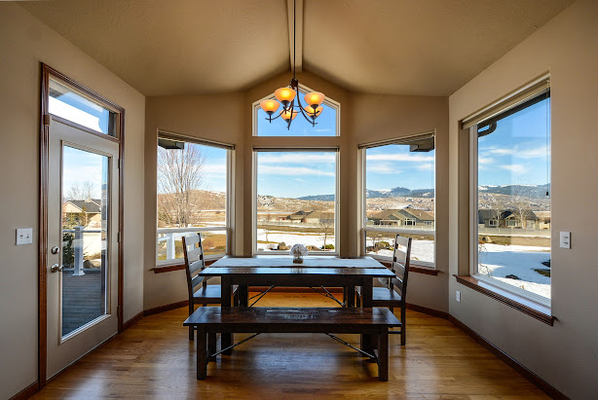
How Homes Sell
Understanding How Buyers Evaluate Homes
The marketing I will do to promote your home has only one purpose - to increase awareness among potential buyers leading to in-person showings.
Once buyers reach your front door, the job of marketing is over. Now it’s time for your home to sell itself.
Your home must compete with other homes in two areas:
Features
Price
If your home has more features that appeal to buyers - or your home is priced lower than comparable homes - your home will stand out as the better value.
Conversely, if your home lacks the features that potential buyers desire at a given price point, your only option is to compete on price.
To be effective, your home should stand out as one of the top two to three best values in your immediate marketplace.

Slide 10
The First Step is Critically Important
Understanding How Buyers Evaluate Homes
The marketing I will do to promote your home has only one purpose - to increase awareness among potential buyers leading to in-person showings.
Once buyers reach your front door, the job of marketing is over. Now it’s time for your home to sell itself.
Before opening the door to potential buyers, your home must be made “real-estate ready”.

Slide 11
Condition
Preparing Your Home For A Successful Sale
With the typical agent, you only discover potential deal-killing repairs after you are already under contract - when the buyer hires a home inspector to scrutinize every aspect of your home.
Discovering and repairing problems prior to the marketing process places you in control, eliminating the stress of making repairs hurriedly on the buyer’s schedule. Having your house in move-in condition also helps you avoid delays to closing and demonstrates to buyers, agents and the buyer’s home inspector that your house has been very well maintained. We want buyers to focus on how they would live in your home - not what they would have to repair.
Additionally, your house will stand out from the competition as a better value and command a higher price.
I can also recommend trustworthy, professional contractors to address any repairs that may be needed. The extent to which these repairs are made will directly affect your listing price. You have the ability to command a higher asking price and substantiate it, when your home is in top condition.
Buyers want a home that is “move-in ready”, and will often disregard homes that are messy, dirty, or in need of repair.
In a Maritz Research poll, 63% of buyers responded that they would pay more for a house that is move-in ready.

Slide 12

Condition
Home Staging
Once any necessary repairs have been completed, we will focus on presentation. You will only get one opportunity to make a positive first impression with potential buyers.
Well staged homes look better, photograph better, show better and sell faster than non-staged homes.
When you list - and close - your home with me, we will provide you with expert personalized staging advice to present your home in the best possible showing light.
Home staging is not decorating. Decorating appeals to the person living in the house; staging is positioning the home to appeal to the psychological needs of buyers by creating a series of impressions that build an emotional connection to help buyers imagine living in the home.
An AOL Money & Finance poll revealed that 87% of respondents said home presentation makes a positive difference in most sales.
Also, while many seller agents overlook the presentation of your home and push for price reductions, the problems, whether perceived or real, still exist.

Slide 13




Home Warranty
While your home is listed with me, it will be covered by a nationally-recognized home warranty from Blue Ribbon Home Warranty, 2-10 Home Warranty, First American Home Warranty, Fidelity Home Warranty, or the home warranty company of your choice. The benefit to you is that many of the expensive home system repairs are covered under this plan while your home is listed.
By advertising a comprehensive warranty for your home, we increase buyer confidence in your home and set you apart from the competition.

Slide 14
Price
Pricing Your Home For A Successful Sale
Market Value
Factors that Influence Market Value
Supply & Demand
Economic Conditions
Asking & Selling Prices of Competing Homes
Your Home’s Condition
Buyer’s Perception of Your Home
Desirable Features not found in Competing Homes, and,
Desirable Features not found in your home, but found in the competition.
Factors with Little or No Influence on Market Value
The Price the Seller Paid for the House
The Seller’s Desired Net Proceeds
The Amount Spent on Repairs or Improvements
Pricing your home accurately is the most effective way to ensure a successful sale.
Allow me to repeat that - pricing your home accurately is the most effective way to ensure a successful sale.
No amount of marketing can sell an overpriced home.
Many sellers are tempted to list their home with the agent who quotes the highest price. This just causes the home to languish on the market while others get sold.
Please keep in mind, the agent doesn’t set the price, the seller doesn’t set the price - the market will set the price, or value, for your home.
Zillow does not set the price either. An example….

Slide 15
Price
Zesti-failure
Market Value
Factors that Influence Market Value
Supply & Demand
Economic Conditions
Asking & Selling Prices of Competing Homes
Your Home’s Condition
Buyer’s Perception of Your Home
Desirable Features not found in Competing Homes, and,
Desirable Features not found in your home, but found in the competition.
Factors with Little or No Influence on Market Value
The Price the Seller Paid for the House
The Seller’s Desired Net Proceeds
The Amount Spent on Repairs or Improvements
Zillow does not set the price either. An example….
Spencer Rascoff, the former CEO of Zillow, recently sold his home in the Seattle area. The Zillow Zestimate was just over $1.5 million, but the house actually sold for $1.1 million. The ZILLOW ZESTIMATE was off by nearly $400,000, and he’s the CEO of Zillow.
Zillow actually states on their website that their Zestimates could be off by as much as 7.9%. On a $400,000 home that’s +- $31,600.

Slide 16
Price
Pricing Your Home For A Successful Sale
Market Value
Factors that Influence Market Value
Supply & Demand
Economic Conditions
Asking & Selling Prices of Competing Homes
Your Home’s Condition
Buyer’s Perception of Your Home
Desirable Features not found in Competing Homes, and,
Desirable Features not found in your home, but found in the competition.
Factors with Little or No Influence on Market Value
The Price the Seller Paid for the House
The Seller’s Desired Net Proceeds
The Amount Spent on Repairs or Improvements
We will use a multi-step approach to arrive at a List Price that will attract the greatest number of qualified buyers to view your home in the most important listing window – the first 2 weeks.
After that first 2 weeks, if your home is found to be not the correct combination of features for the price, showing activity will slow dramatically as interested buyers will have moved on, and we will need to chase after the buyers with price reductions. This is not a desirable situation.
Remember, they are using the Internet to compare your home against every other home, before they even set foot in your home.

Slide 17
Price
Pricing Your Home For A Successful Sale
Market Value
Factors that Influence Market Value
Supply & Demand
Economic Conditions
Asking & Selling Prices of Competing Homes
Your Home’s Condition
Buyer’s Perception of Your Home
Desirable Features not found in Competing Homes, and,
Desirable Features not found in your home, but found in the competition.
Factors with Little or No Influence on Market Value
The Price the Seller Paid for the House
The Seller’s Desired Net Proceeds
The Amount Spent on Repairs or Improvements
The multi-step approach to pricing:
We will build a list of all recent listings and sales in the area.
We will create a matrix of features vs price for all homes in that list.
We will visit all actively listed homes in the list to see how yours compares.
Together, we will compare each home to yours, feature by feature, to establish a List Price that will ensure that your home is at the top of everyone’s list.

Slide 18
Price
Pricing Your Home For A Successful Sale
Market Value
Factors that Influence Market Value
Supply & Demand
Economic Conditions
Asking & Selling Prices of Competing Homes
Your Home’s Condition
Buyer’s Perception of Your Home
Desirable Features not found in Competing Homes, and,
Desirable Features not found in your home, but found in the competition.
Factors with Little or No Influence on Market Value
The Price the Seller Paid for the House
The Seller’s Desired Net Proceeds
The Amount Spent on Repairs or Improvements
Pricing your home accurately is the most effective way to ensure a timely, successful sale.
Allow me to repeat that - pricing your home accurately is the most effective way to ensure a timely, successful sale.
No amount of marketing can sell an overpriced home.
Many sellers are tempted to list their home with the agent who quotes the highest price. In the real estate industry, we call that “buying the listing”.
This is completely unfair to the Seller because it creates an unrealistic expectation in the mind of the Seller, and severely limits the pool of interested Buyers.
Please keep in mind, the agent doesn’t set the selling price, the seller doesn’t set the selling price - the market (buyers) will set the price, or value, for your home when they start making purchase offers.

Slide 19

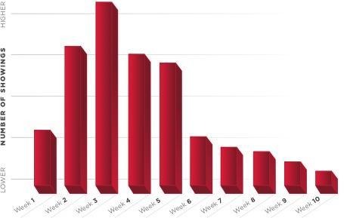
MARKETING VALUE STRATEGIES
^{Pricing & Property Appeal}
^{Showings Per Week}
^{Overpricing your home can mean}
a decrease in interested buyers
^{and an increase}
^{in days on the market.}
^{This chart shows how time}
^{on the market can affect the}
^{number of showings per week.}

Slide 20


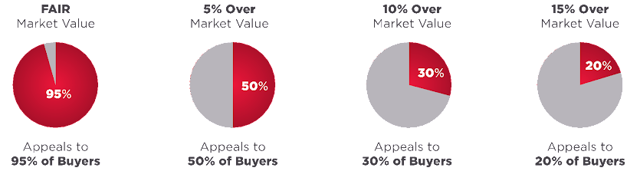
^{Pricing & Property Appeal}
In order to get the maximum number of eyes on your home, the initial list price must be set at a number that will attract the highest number of potential buyers.
The more buyers that are interested in seeing your home, then the more offers that you will receive, thus driving up the eventual selling price in a competitive bidding environment.
MARKETING VALUE STRATEGIES

Slide 21

Marketing
MARKETING YOUR HOME FOR A SUCCESSFUL SALE
Your home is now priced accurately, is in excellent condition, and looks great.
Let’s show it off!
The marketing of your home will reflect an established history of how buyers search for, and purchase, homes.
• 95% (or more) of buyers use the Internet during their home search.
• ~90% of all home sales in the Denver area are co-brokered. This means there is a listing agent who represents you, the seller. And there is another agent who represents the buyer of your home. As a result, marketing to Realtors® is our most productive activity.
• The most effective way to get the attention of productive agents and buyers is through accurate pricing and high-definition professional real estate photography.

Slide 22

Marketing
PROFESSIONAL PHOTOGRAPHY
  After your home is staged, one of our professional real estate photographers will photograph every important aspect of your home in vivid HDR detail, so it is exceptionally important that the pictures sparkle.
  Therefore, it will be necessary to clean and shine all surfaces that will appear in the photographs.
  With 95% of buyers using the Internet to search for homes, professional photography is essential to any comprehensive marketing plan.
  More people will view your home online than will ever visit it in person. Getting, and holding, their attention online with professional photography is the primary way to increase the probability of an in-person showing.
  “Buyers perceive homes with professional photography to be worth, on average, 12% more than the actual price.”
  The Wall Street Journal

Slide 23
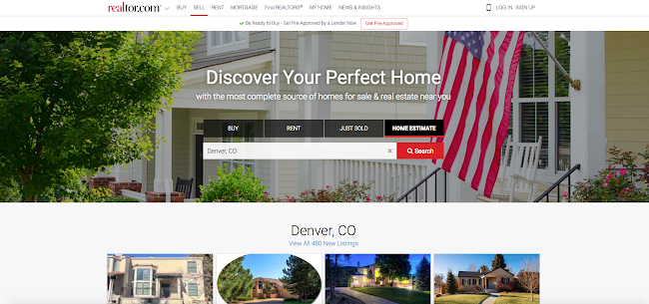
Marketing
INTERNET MARKETING
Your home will be prominently featured on Realtor.com, one of the top real estate web sites in the nation.
Features of your showcase listing include:
• Up to 40 oversized photos
• High-definition video tour
• Detailed descriptions of your home.
• Interactive maps
• Open house notices
• Lead generation forms for potential buyers

Slide 24














Marketing
INTERNET MARKETING
I will place your home on hundreds of the world’s leading real estate web sites for unmatched exposure.
Here are just a few of the sites where your home
could be found. . .

Slide 25
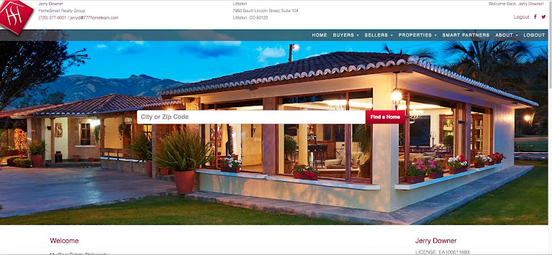
Marketing
INTERNET MARKETING
Your home will be featured on all of our web sites where it can be seen by thousands of daily visitors.
It will also be seen on websites belonging to other real estate companies because we have syndication agreements with them.
Your home is also directly accessible by more than 600 Leading Real Estate Companies of the World affiliates with offices across the country and around the world.
Additionally, all open houses are promoted on our web site, on realtor.com, and on recolorado.com, increasing the exposure of your home.

Slide 26
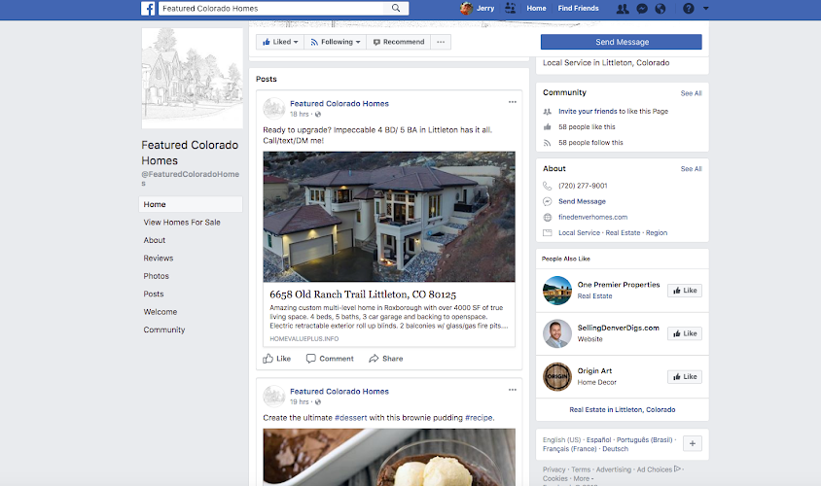
Marketing
SOCIAL MEDIA MARKETING
Your home will also be marketed extensively on Facebook and Instagram, the world’s leading social media sites.
I will market your home using several proven approaches, including highly-targeted ads, video, photos and more.
Both Facebook and Instagram represent an opportunity to reach tens of thousands of local Colorado residents on a site where they already spend a lot of time.

Slide 27
Marketing
E-MAIL MARKETING
Your home will also be marketed using the latest video email technology, enabling agents and potential buyers to watch a hi-definition video of your home directly from their email.
Sent to more than 8,000 active real estate agents and area residents, these emails have generated a tremendous response for my clients - leading to increased awareness and showings! I am one of the few agents in the Denver area to offer this advanced marketing service.
Here’s what just a few agents have said about a recent video they received; “Jerry, what a GREAT video. I so enjoyed the personal touch of the homeowners. I would show this house in a heartbeat! Thanks so much for sharing!”
Michelle xxxxxx
“Jerry, what a wonderful marketing tool. I love having your clients in the video - great touch! Best of luck with this remarkable home.”
Jennifer xxxxxx
“Hi Jerry, thank you for sending the video tours. . .they are awesome! Please keep me on your mailing list!”
Gale xxxxxx

Slide 28

Marketing
A MARKET WITHIN A MARKET
Your home will not only be marketed through universal channels such as social media, YouTube, print advertising (targeted mailers), the Multiple Listing Service, and signage. I will also market internally to our highly collaborative REAL national team of over 11,000 agents, each with their own network of connections that forms a rich source of prospects, buyers and referrals.
This “market within a market” results in the most efficient transaction environment in Colorado real estate.
We also have a nationwide referral network, and the details about your home will be visible to every one of our agents across the country.

Slide 29
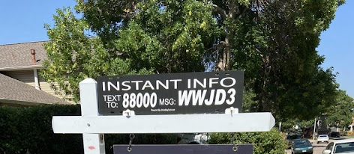
Marketing
Electronic Flyers
I will add a rider to the top of your yard sign that will allow prospective buyers to send a text code to our text message service provider.
In response to the text code, we will deliver a link to a single property website created specifically for your home listing. This website will provide full listing information regarding your property.
There are numerous advantages for you;
• Potential buyers are able to immediately access a detailed description of your home, along with beautiful photos and video. We can also make useful documents available such as your Seller’s Disclosure, Inspection Report and more.
• Unlike paper flyers, I receive an immediate notification with the potential buyer’s cell phone number, allowing me to follow up while the prospective buyer is still in your neighborhood. With a paper flyer, we have to wait until they call us - if they ever do.
• This technology is the flyer box that is never empty. Nothing is more frustrating to potential buyers - and sellers - than an empty flyer box!

Slide 30

But Wait.
How about doing something really different?
All of those marketing ideas in the previous slides are nothing new. I’ve just taken a bunch of standard ideas and re-packaged them. But still, that package of ideas is more than most other agents come up with.
But here’s where I take a different path:
And I will explain it in more detail when we meet.

Slide 31

Service
WHAT ELSE YOU CAN EXPECT FROM ME
In addition to the services we’ve covered, you can expect me to provide the following:
• Attentive one-on-one service. The responsibility of managing the sale of your home is never passed off to other agents or unlicensed assistants. I am present for every Open House showing and Inspection to ensure your home is presented properly and to gather valuable feedback.
• Regular communications regarding every aspect of my efforts and the results of those efforts as well as any changes in the market, including new listings, price changes of competing homes, sales, and how we should re-position your property to remain competitive.
• Negotiating offers and preparing contracts.
• Monitoring the Closing preparations to ensure all contract provisions have been met and that you are fully satisfied with the results of your sale.

Slide 32
My Support Team
Full service, and then some.
While most real estate agents are completely on their own through the entire transaction, our Denver's Home Team agents have a complete support system available to ensure a successful stress-free transaction for our clients.
These are some of the various team job functions, and how they support my value proposition:
Multiple Managing Brokers
Contract compliance manager
Marketing Team
Vacation coverage team
Relocation coordinators
Exclusive agreement with Virtuance Photography
Appraisers and Home Inspectors on call

Slide 33

Thank you
Thank you for the privilege and opportunity to work with you. As always, feel free to call me if you have any questions. I look forward to meeting with you and helping you achieve a successful sale.
Jerry Downer
Realtor / Broker
Real
Office and Cell: (720) 277-9001
jerrydowner@jjdre.com
SellSmartUSA.com
DenversHomeTeam.com

Slide 34
Professionalism
Unlike discount brokerages, Denvers Home Team at Real does not employ “part-time” agents. We understand that proper fiduciary representation can not be accomplished by an agent who is attempting to sell someone’s home in their “spare time”.
We are committed to fully represent your best interests with our entire team of full-time professionals.

Slide 35
One More Option…
Buy Before You Sell
The Buy Before You Sell program turns traditional real estate Selling Then Buying upside down. It is one of the most innovative methods of Selling and Buying real estate, and the cost is minimal.
It is essentially a bridge loan but with extra perks.
The Buy Before You Sell equity advance lender will advance the major part of your current home's equity to you to use as a down payment on your next home. You can purchase that next home as a non-contingent Buyer, which means that your next home purchase is not dependent on the sale of your current home, and the Seller of your next home will look at your proposal more favorably.
After you complete the purchase of that next home we will start preparing and marketing your previous home for sale. You may even be eligible to receive up to $35,000 in fix-up expenses to make the home more appealing to buyers. A clean updated vacant home is much more appealing to buyers, especially if they can move in quickly.
During this marketing period you will only be making one mortgage payment, not two.
Once your previous home is sold you will receive the full sales price, less my discounted real estate commission (no markup), less the fix-up expenses if any, less the payoff of the previous mortgage if any, and less a 2.25% or 2.4% service fee to the equity advance partner. The fee is overwhelmingly offset by the fact that I charge a reduced real estate commission for participants in this program, and also by the fact that you never have to put up with showings, never need to keep the home "model home clean", never need to rent a storage unit, never need to arrange for temporary interim housing, and you only need to move once.

Slide 36
Preparing To Sell Your Home In Four Common-sense Steps
Step 2
Step 3
Step 4

Slide 37
Step 2…step 1 was making the decision to sell
Accept the fact that the single most important factor in getting your home sold is "Seller Decisions". You, as the seller, determine List Price, Condition of your home, Showing availability, Contract acceptance, and the Realtor that you choose.
Choosing the right Realtor will allow you to have a consultant in your corner who can provide advice and recommendations about those decisions.

Slide 38
Step 3 … Hire A Critic
This is a good time to have a Realtor, who is not afraid of saying NO.
This is not a good time to consult with someone who agrees with everything that you say. That will stifle progress.
You need to have someone looking at your home as a buyer would look at it, pointing out every flaw that could lower the price, and making recommendations that could increase the price.
You live in it, so there are things you don't notice anymore.
You look beyond the clutter, but the buyer sees clutter.
You don't notice the dirt build-up and smudges, but the buyer sees that it's dirty.
You don't notice the faded paint and flooring, but the buyer thinks that he's going to have to paint and update the flooring.
You don't notice the minor cracks and squeeks, but the buyer is wondering what else is broken.
Have you ever traded in a car for a new one? Didn't you clean it up or get it detailed so it had a higher trade-in value? The same principle applies here.

Slide 39
Step 4 … If you didn't hire a Realtor back in Step 2, now is the time to do so.
But who should you hire? The most obvious answer is ME, of course. But sadly, not everyone agrees with me initially.
So here are some characteristics that you should be looking for:
  Your Realtor should have a system in place that will enable him to know your home quickly.
  Your Realtor should know what's happening in all the markets that matter, both hyperlocal and local.
  Your Realtor should be able to give you your odds of selling, and a reasonable timeframe in which to accomplish the sale.
  Your Realtor should be your homes' critic (go back and read Step 2).
  Your Realtor should not agree with "everything" that you say.
  Your Realtor should not make decisions that you should be making, but instead should guide you in making the best housing decisions based on his years of experience as a Realtor in our market area.
  Your Realtor should be an expert in real estate negotiations.
  Your Realtor should understand the nuances of the Colorado Department of Real Estate approved contracts and disclosures.
  Your Realtor should have Project Management experience.
  Your Realtor should have a plan specific to your home,
  Your Realtor should communicate with you consistently.
  Your Realtor should have a team of real estate professionals to include Inspections, Photography, Staging, Marketing, Social Media, Administration, Transaction Coordination, .............
If your Realtor fails any of these tests, get someone like me who satisfies every one of these. Failure can cost you money.

Slide 40
What we do for you:
We do more for you than other agents at every stage of the home selling process. And we are able to prove this in a side by side comparison. Major listing stages:
  Pre-listing prior to signed listing agreement
  Prep for market with signed listing agreement (before photography)
  Pre-market (week before going live)
  Active on MLS
  Receiving and reviewing offers
  Offers received
  Under Contract
  Pre-Closing
  Closing
  Post-Closing

Slide 41
Let’s go into detail about the major listing stages

Slide 42
1. Pre-listing prior to signed listing agreement
Tour the home
  Take notes
  Listen for seller's points of emphasis
Why are you moving?
Finding potential sellers
Market research and CMA
Listing appointment with multi-month calendar pages

Slide 43
2. Prep for market with signed listing agreement (before photography)
Timeline, urgency, and stress level
Declutter / de-personalize appointment
Inspect for fixup/touchup
Inspect for curb appeal
Inspect to identify possible inspection objections
Gather HOA, receipts for major improvements, warranties, utility bills, any other due diligence docs
Start SPDS and other disclosures
Measurements
Deep clean

Slide 44
3. Pre-market (week before going live)
Timeline, urgency, and stress level
Last minute cleaning and touch-up
Photography appointment
Schedule Broker Open
Schedule Public Open

Slide 45
4. Active on MLS
Timeline, urgency, and stress level
Publicize, coordinate, and conduct open houses
Video of open houses from street view

Slide 46
5. Receiving and Reviewing Offers
Timeline, urgency, and stress level
Acknowledge each offer as they arrive
Build comparison matrix
Send copy of offer with high points noted to seller
Continue accepting offers until cut-off date / time

Slide 47
6. Offers received
Timeline, urgency, and stress level
Compare all offers
Verbally counter most promising offers
Negotiate best offers

Slide 48
7. Under Contract
Review longer timeline, urgency, and stress level
Point out areas of contention and negotiation
Manage expectations
Point out activities and requirements
Alleviate any stressors
Communicate often and regularly

Slide 49
8. Pre-Closing
Discuss process
Review contract obligations of seller. Validate completion

Slide 50
9. Closing
Attend closing to monitor and handle contingencies

Slide 51
10. Post-Closing
Manage potential situations
Discuss PCOA responsibilities including renter’s insurance and property condition

Slide 52
Summary
The bullet points behind each of the major listing stages only show the outline. Each of those bullet points also has a comprehensive detailed checklist of tasks to be performed before we are able to move on to the next bullet point.
We promise not to overlook any detail.
  Pre-listing prior to signed listing agreement
  Prep for market with signed listing agreement (before photography)
  Pre-market (week before going live)
  Active on MLS
  Receiving and reviewing offers
  Offers received
  Under Contract
  Pre-Closing
  Closing
  Post-Closing

